Slide 1
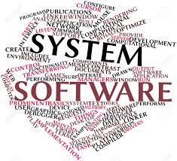

Distinguish between system software and application software

Slide 2
SOFTWARE
Software is the collection of data, programs, procedures, routines and instructions that tell a computer or electronic device

Slide 3
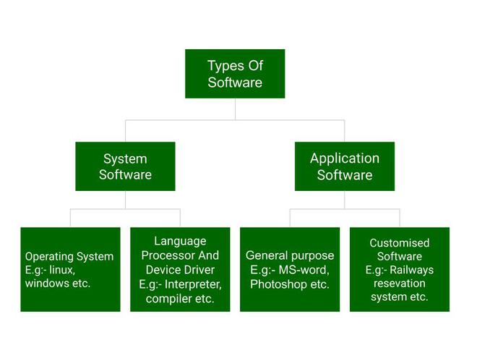

Slide 4
SOFTWARE
System software basically controls a computer’s internal functioning and also controls hardware devices such as monitors, printers, and storage devices, etc
Application Software is a type of computer program that performs specific functions. These functions, performed by application software, can be personal, business as well as educational.

Slide 5
Difference between system software and application software
System Software
Application Software
It is designed to manage the resources of the computer system, like memory and process management, etc
Written in a low-level language
Less interactive for the users
System software plays vital role for the effective functioning of a system
It is designed to fulfill the requirements of the user for performing specific tasks.
Written in a high-level language
Written in a high-level language
Application software is not so important for the functioning of the system, as it is task specific.

Slide 6


Difference between Linux and Windows

Slide 7
LINUX
Linux was originally built by Linus Torvalds
It is an Open Source operating system
Linux was built based on UNIX

Slide 8
WINDOWS
Windows may be a commissioned OS it’s designed for the people with the angle of getting no programming information and for business and alternative industrial users. it’s terribly straightforward and simple to use.

Slide 9
Difference between Linux and Windows
LINUX
Linux is a open source operating system .
Linux is free of cost.
It's file name case-sensitive.
In Linux, monolithic kernel is used.
There is forward slash issued for separating the directories.
Linux provides more security than windows.
Linux is widely used in hacking purpose-based system.
Linux is widely used in hacking purpose-based systems.
WINDOWS
Windows are not the open source operating system.
While it is costly.
While it's file name iis case insensitive.
While in this ,micro kernel is used
While windows are less efficient.
While there is back slash is used for Separating the directories.
While it provides less security than Linux
While windows does not provide much efficiency in hacking.

Slide 10
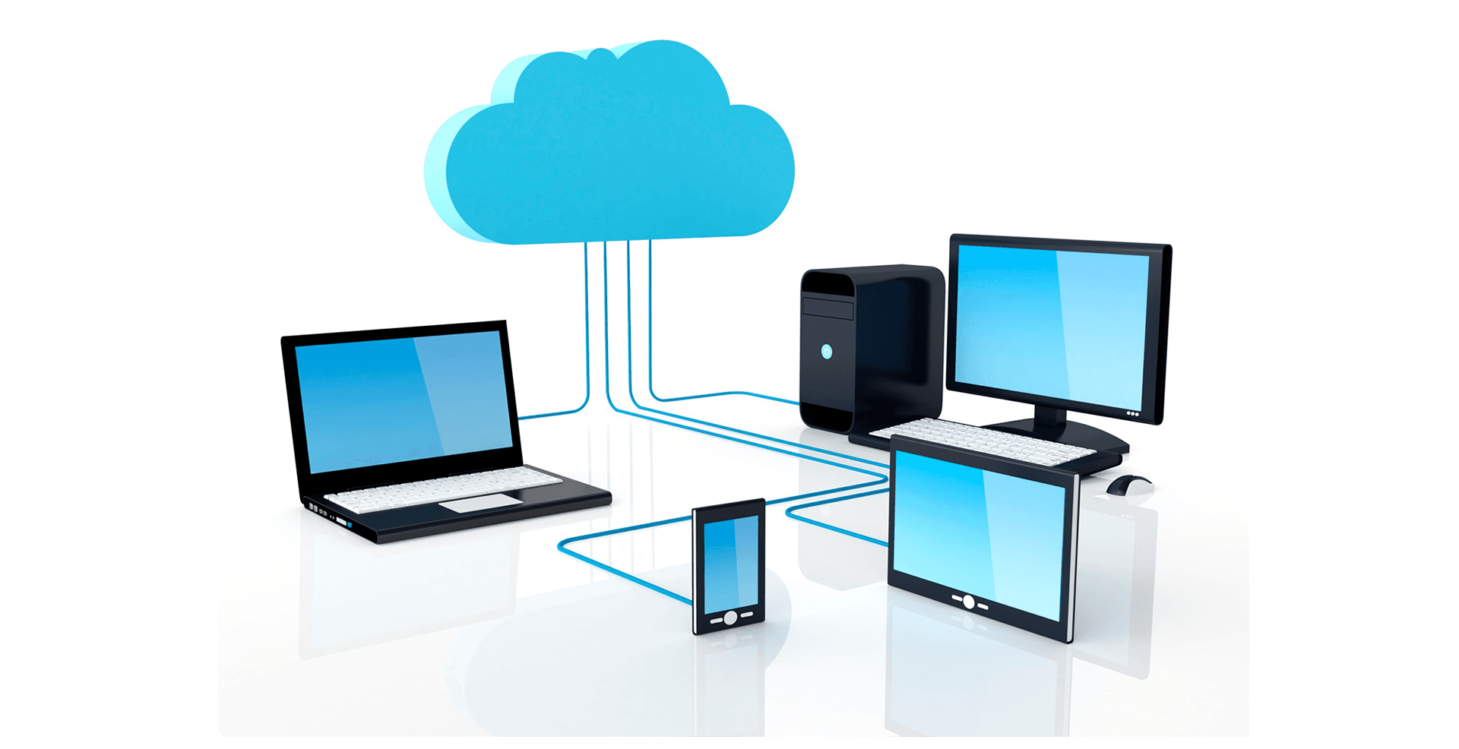
Proxy Server

Slide 11

Purposes of Proxy Server:
Faster access to the requested resources.
Enables high security.
Undesired sites are blocked.
Contents are scanned for spyware
Outbound content is also scanned.
Increases performance.
Requests can be filtered.

Slide 12
Four Different of Proxy Server:
International Proxy
01
Anonymous Proxy
02
Transparent Proxy
03
Reverse Proxy
04

Slide 13
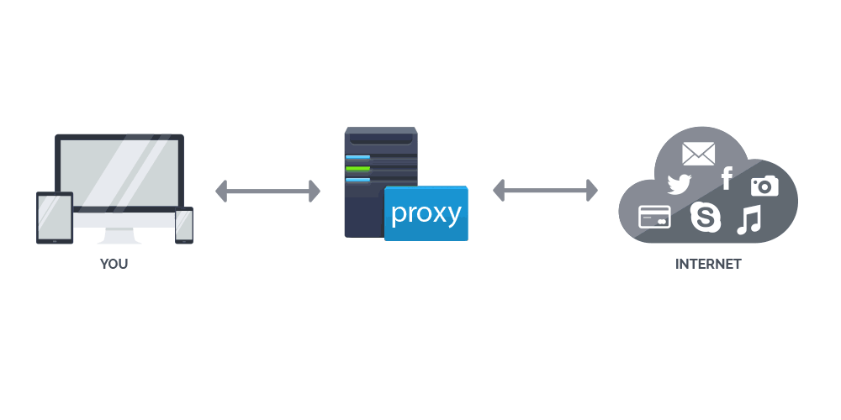
Anonymous Proxy
It does not show itself like a proxy server and it does not show the genuine IP address.

Slide 14
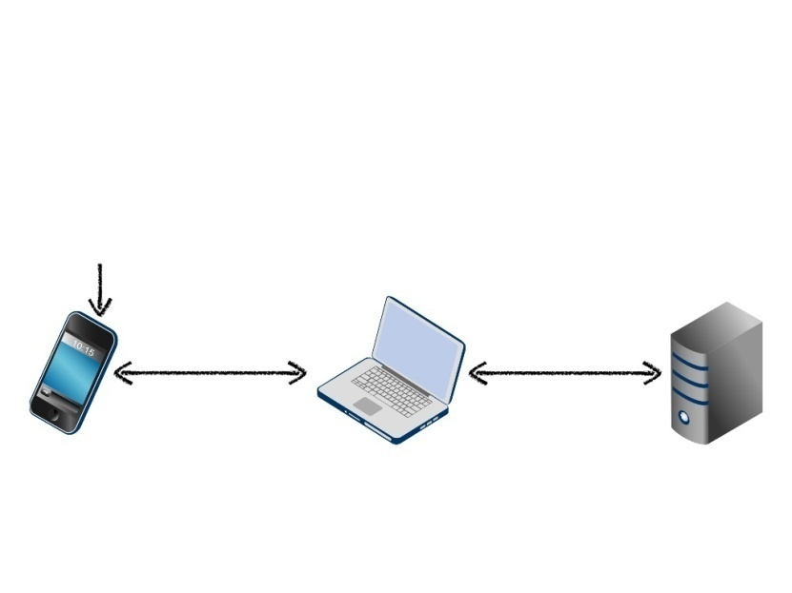
Intercepting Proxy
An intercepting proxy, also known as a transparent proxy, combines a proxy server with a gateway. Connections made by client browsers through the gateway are redirected through the proxy without client-side configuration.

Slide 15
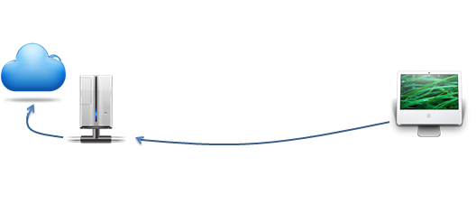
Transparent Proxy
A transparent proxy is a server that satisfies the definition of a proxy, but does not enforce any local policies. It means that it does not add, delete or modify attributes or modify information within messages it forwards.

Slide 16
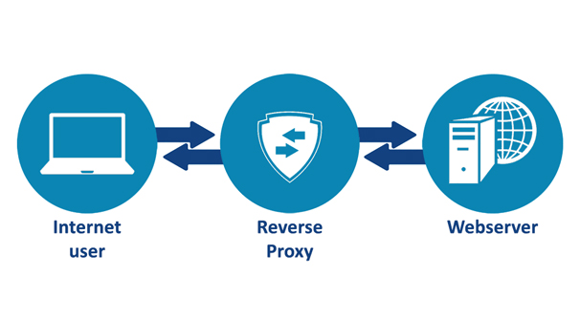
Reverse Proxy
A reverse proxy is another common form of a proxy server and is generally used to pass requests from the Internet, through a firewall to isolated, private networks.

Slide 17
THANK YOU

